Slide 1
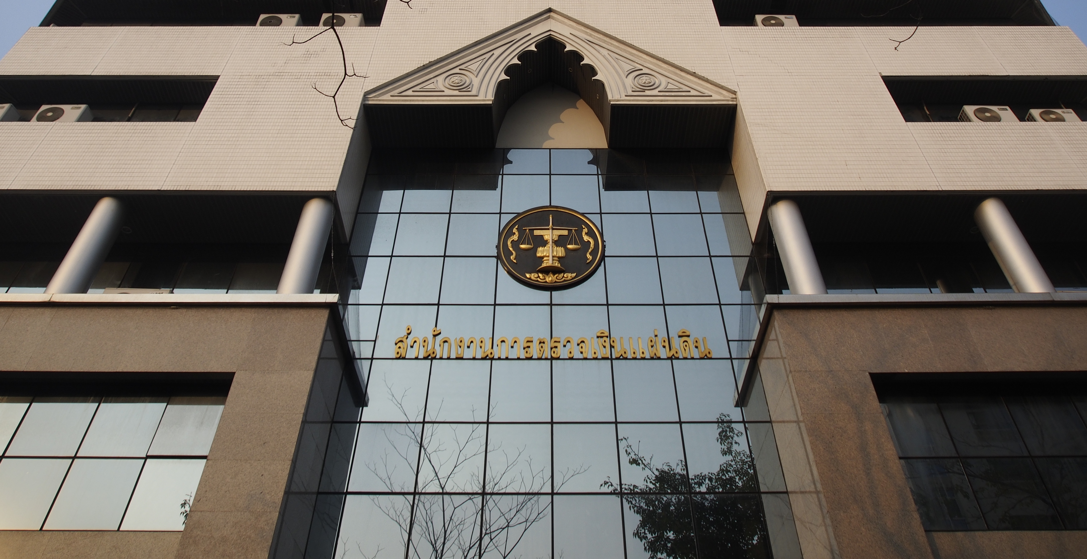
Office of the Auditor General of Thailand

Slide 3
Our History

Slide 4
OAG Structure
STATE AUDIT COMMISSION
OFFICE OF THE AUDITOR GENERAL
AUDITOR GENARAL
Internal
Control
Div.
Central Audit Offices (29)
Regional Audit Offices
Regional Special Audit Offices No.1-15 (15)
Provincial Audit Offices (76)
Supportive Offices (11)

Slide 5
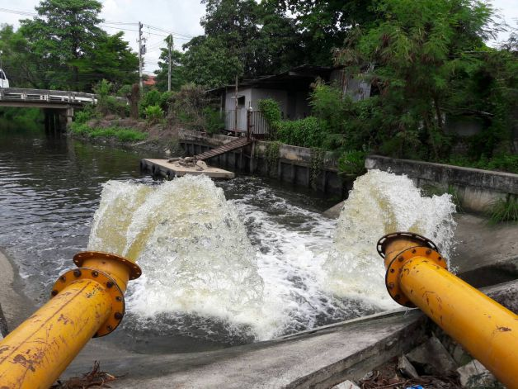
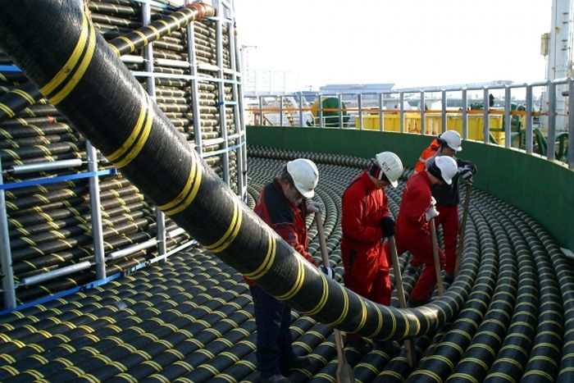
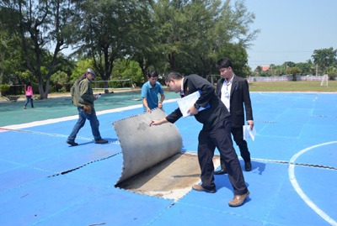
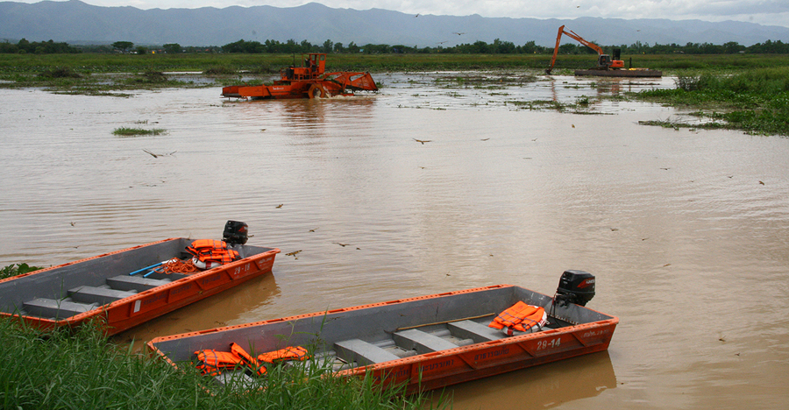
Audit coverage
Financial Audit
Performance Audit
Procurement Audit
Investigative Audit
Revenue Collection Audit

Slide 6
Audit Mandate
The Organic Act of State Audit B.E. 2542 (1999)
Section 39 Office of the Auditor General has the powers and duties in connection with general affairs of the Commission and shall have the following powers and duties:
…………….
to audit receipt and payment, the retention, and disbursement of money and other properties belonging to or being within the responsibility of the audited agency and give opinions as to whether it is in compliance with the laws, rules, regulations or resolutions of the Council of Ministers, and to, as it wishes, audit the disbursement of money and use of other properties or the procurement under a given plan, work or project of an audited agency and give opinions as to whether they are in compliance with the objectives, economical, worthwhile and achieve their goals.
…………….

Slide 7
Public Procurement in Thailand
Legal Framework
The Public Procurement and Inventory Act B.E. 2560 (2017) and the rules, regulations, and announcement under it.
3 Methods under the PPI Act
- Open procedure
- Selected procedure
- Specific procedure

Slide 8
Public Procurement in Thailand
However, since 2005 to 2017 procurements valued at above 2 million baht have to be conducted through an electronic auction (e-auction) and from 2016 the electronic means has changed to e-bidding and e-market

Slide 9
Public Procurement in Thailand
Generally, all procuring agencies must announce their procurements on the Governments’ central procurement website (www.gprocurement.go.th) and relevant agencies’ websites.
Additionally, they must make these announcements to the Mass Communication Authority of Thailand, the Broadcasting Authority, and the Office of the Auditor General of Thailand.

Slide 10
Public Procurement Audit
OAG Thailand conducts procurement audit through procurement and investigative audit offices. There are;
- 5 procurement audit units ( Procurement and Investigative Offices 1-5) in the headquarter
- 15 procurement and investigative audit units in regional audit offices (Regional Special Audit Offices 1-15)
- 76 procurement and investigative audit units in provincial audit offices

Slide 11
Public Procurement Audit
Presently, the public procurement auditing of OAG makes recommendation to the 4 phases of procurement as following:
1) preparation of procurement plan
2) tendering and awarding processes
3) contract management
4) utilization

Slide 12
Public Procurement Audit
preparation of procurement plan
The law states that audited entity must submit to OAG;
- procurement plan during the first month of fiscal year
- every procurement notice, and contract above the threshold
OAG uses those documents for risk analysis to plan the audit.
Risk area : The changes of budget category after it has been approved risking inappropriate consideration.

Slide 13
Public Procurement Audit
2) tendering and awarding processes
OAG will examine the accuracy of the tendering and awarding processes, examine all documents in procurement procedures. Initially, the auditor will check main processes as followings;
(1) The identification of needs should be clarified in the request procurement report of procuring agency. In particular, obvious specification of procuring items should be broad and open for competition.
Risk area : Unfair, non-competitive TOR

Slide 14
Public Procurement Audit
(2) The bidding documents should clearly define the bid evaluation criteria. Also adequate publicity and time have been allowed for the prospective bidders to respond.
(3) The bidding documents should obviously describe the form of bid under the standard bidding documents.
(4) The bidding documents have to be accurately and clearly about the work, location, procuring items, plan and schedule of delivery and installation.

Slide 15
Public Procurement Audit
(5) Bidding process must be disclosure to the public under concept of transparency, fairness, non discrimination, and competitive procurement market.
(6) The estimated cost should be reasonable prices beneficial to the government.
Risk area: The exposure of budget and the standard price index.
(7) The evaluation committee must be qualified and does not include anyone with a personal interest in the contract. In other words, the auditor will examine the conflict of interest behaviour in public procurement.

Slide 16
Public Procurement Audit
(8) The criteria and methodology for selection of awarding bidder should be accordance with the bidding documents.
(9) The decisions and reasons of all evaluation committees have to be recorded and could notify to the third persons clearly. Under the principle of bid evaluation, the evaluation procedure will be confidential.
(10) Terms and conditions of contract have to be the same in the invitation bidding stage

Slide 17
Public Procurement Audit
3) contract management
examine the execution of public procurement contract.
delivery of goods is different from the one specified in the identification of needs.
review the extension of time of supply of goods, equipment, and public works construction which should be completed within the time in contract.
in case of contract adjustment, it shouldn't change the subject matter of the procurement and shouldn’t effect the price in substantial amount.
Review the documents attach to the contract and any procedure has to be done according to the contract.

Slide 18
Public Procurement Audit
In order to support principles of transparency and citizen engagement, OAG provides the database of audit entities in awarding of contract. This database, known as Public Procurement Watch with OAG, will show contract information as contract value and name of contractor through http://procurement-oag.in.th/

Slide 19
Public Procurement Audit
Many audit findings in public procurement audit will be revised for developing measure of transparency and accountability in public procurement system. For example, in 2005 OAG proposed the Measure of State audit about public procurement of Sub district Administrative Organizations (SAOs) which this measure explains good practices in each procurement stage of SAOs.

Slide 20
Public Procurement Audit
4) Utilization
Observe the usage of procurement items to evaluate the efficiency and effectiveness of the product/project. In many cases we found out that the products have never been used or projects were abandoned.

Slide 21
As-Is Process Flow:
Main Mission | M4 Procurement Audit
Stages | M4-01 Planning phase (Regular Audit) | p.1
PSP Div. Dir. Dep. Dir. SOAG | Policy and Strategic Planning Office Division Director Department Director Standard of OAG
As-Is Process Flow:
PSP
Procurement Audit Office 1-5
Auditor
Auditor
Auditor
Summary of risk assessment to select audited entity
Issue
opening meeting letter
Preliminary study /
Risk assessment
Selecting
audited entity
Mega Project Audit
yes
M4-01
p.2
- Year plan
- Economic plan
No
Auditor
Div Dir.
Dep. Dir.
Auditor
Develop audit
year plan
Review audit
year plan
approval
yes
Proposed plan to PSP
Year plan
no
No
Auditor
Auditor
Auditor
Div. Dir.
Dep. Dir.
Assess risk to select
project/ contract
Develop audit plan
and methodology
Develop necessary
Permission letter for
engagement
Review audit plan
methodology and
permission letter
approval
Yes
- Permission letter for engagement
- Audit plan and methodology
rules /regulations/ standards/ principles/ guidelines/ handbooks
SOAG 1 code 100 – 140
SOAG 1 code 200
SOAG 1 code 230
ISSAI 1 – 40
ISSAI 400
ISSAI 4000 - 4200
Public procurement audit guideline

Slide 22
As-Is Process Flow:
As-Is Process Flow:
Main Mission | M4 Procurement Audit
Stages | M4-01 Planning phase (Mega Project Audit) | p.2
PSP Div. Dir. Dep. Dir. SOAG | Policy and Strategic Planning Office Division Director Department Director Standard of OAG
As-Is Process Flow:
Procurement Audit Office 1-5
Auditor
Auditor
Div Dir.
Dep. Dir.
Auditor
M4-01
p.1
Assess risk to select
project/ contract
Develop audit
year plan
Review audit
year plan
approval
yes
Proposed plan to PSP
Year plan
no
no
Auditor
Auditor
Div. Dir.
Dep.Dir.
Develop audit plan
and methodology
Develop necessary
Permission letter for
engagement
Review audit plan
methodology and
permission letter
approval
yes
- Permission letter for engagement
- Audit plan and methodology
rules /regulations/ standards/ principles/ guidelines/ handbooks
SOAG 1 code 100 – 140
SOAG 1 code 200
SOAG 1 code 230
ISSAI 1 – 40
ISSAI 400
ISSAI 4000 - 4200
Public procurement audit guideline

Slide 23
Main Mission | M4 Procurement Audit
Stages | M4-02 Data Gathering & Analysis | p.1
As-Is Process Flow:
Offices
M4-03
Audited entity & Team
auditor
Auditor
Opening meeting/
Meet with
management
Data gathering &
analysis
Develop work sheet &
draft report & draft
recommendation letter
- Audit plan and methodology - opening meeting letter
- Work sheet
- Audit evidence
- Draft report - Draft recommendation letter
rules /regulations/ standards/ principles/ guidelines/ handbooks
SOAG 1 code 100 – 140
SOAG 1 code 200
SOAG 1 code 230
ISSAI 1 – 40
ISSAI 400
ISSAI 4000 - 4200
Public procurement audit guideline

Slide 24
Main Mission | M4 Procurement Audit
Stages | M4-03 Reporting | p.1
As-Is Process Flow:
Offices
Audited entity /Supervisory
Div. Dir.
Supervisor - Management
Auditor
Review draft report &
Draft recommendation
letter
Review & approve draft report &
Draft recommendation
letter
Submit draft report &
Draft recommendation
letter
yes
- Work sheet
- Audit evidence
- Draft report - Draft recommendation letter
no
M4-02
no
yes
Supervisor - Management
Audit report with recommendation
Recommendation under sec 44 & 45 (wrong doing)
Approve report &
recommendation
letter
yes
yes
Recommendation letter
Submit the case to Budgetary and Monetary Disciplinary Committee if there are any elements of the disciplinary offence
- Audit report - Recommendation letter
no
no
Case close
Submit to investigative unit
Sec 46 believe to be act of corruption
rules /regulations/ standards/ principles/ guidelines/ handbooks
SOAG 1 code 100 – 140
SOAG 1 code 200
SOAG 1 code 230
ISSAI 1 – 40
ISSAI 400
ISSAI 4000 - 4200
Public procurement audit guideline

Slide 25
Main Mission | M4 Procurement Audit
Stages | M4-04 Follow up | p.1
As-Is Process Flow:
Audited entity
Offices
Recommendation letter
M4-04
(p.2)
Auditor
Auditor
Div. Dir.
Supervisor - Management
Takes action
yes
Review the action
Draft consideration paper
/draft the 2nd
recommendation letter
Review
Approval
no
M4-04
(p.2)
2nd
recommendation letter
Case close
rules /regulations/ standards/ principles/ guidelines/ handbooks
SOAG 1 code 100 – 140
SOAG 1 code 200
SOAG 1 code 230
ISSAI 1 – 40
ISSAI 400
Guideline on following up audit recommendation

Slide 26
Main mission | M4 Procurement Audit
Stages | M4-04 Follow up | p.2
As-Is Process Flow:
Offices
Audited entity/
Supervisory entity
M4-04
(น.1)
M4-04
(p.1)
Auditor
Supervisor - Management
Auditor
2nd
recommendation letter
Review & Approve
2nd
recommendation letter
Submit 2nd
recommendation letter
2nd
recommendation letter
no
Takes action
yes
M4-04
(p.1)
Auditor
Supervisor - Management
Auditor
3rd recommendation
letter
Review & Approve
3rd recommendation
letter
Submit 3rd
recommendation
letter
3rd recommendation
letter
Auditor
yes
Report to SAC/AG
For consideration
no
Takes action
rules /regulations/ standards/ principles/ guidelines/ handbooks
SOAG 1 code 100 – 140
SOAG 1 code 200
SOAG 1 code 230
ISSAI 1 – 40
ISSAI 400 400
Guideline on following up audit recommendation

Slide 27
OAG in ACTION!

Slide 28
Thank you for your attention
Kob Koon Ka/Krup

